Slide 1
Final Project:
Milestone Week 2 Update
Trevor Lau, Jenna Rutberg, Celine Semaan, & Alexander Williamson

Slide 2
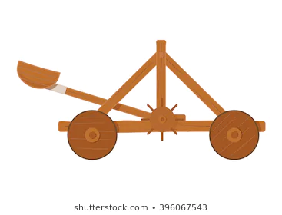
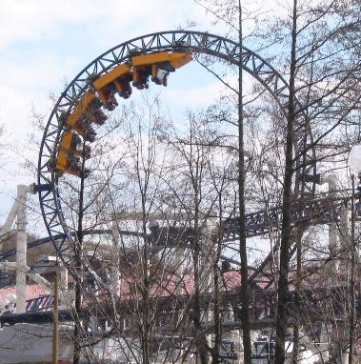
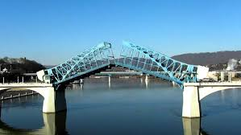
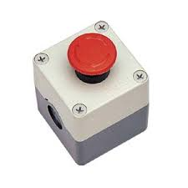

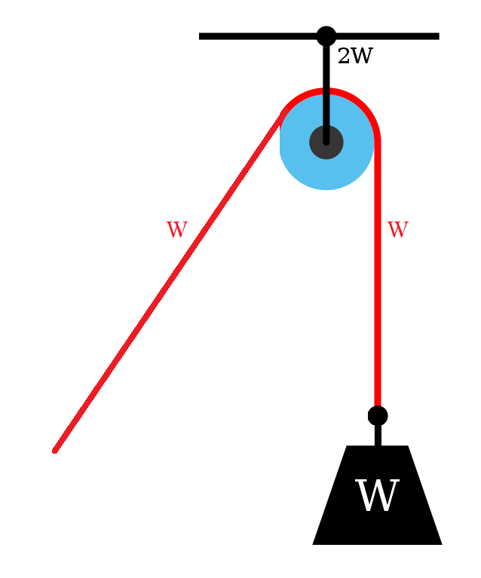
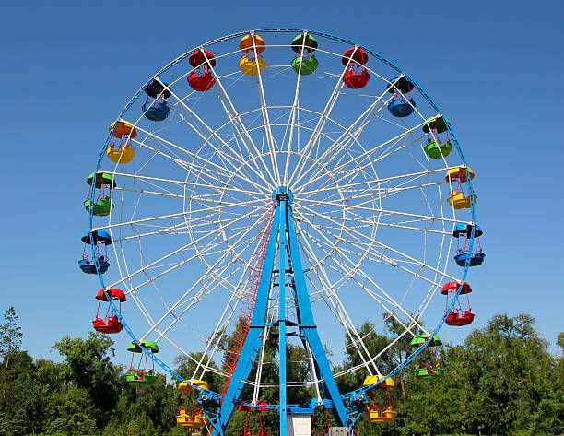
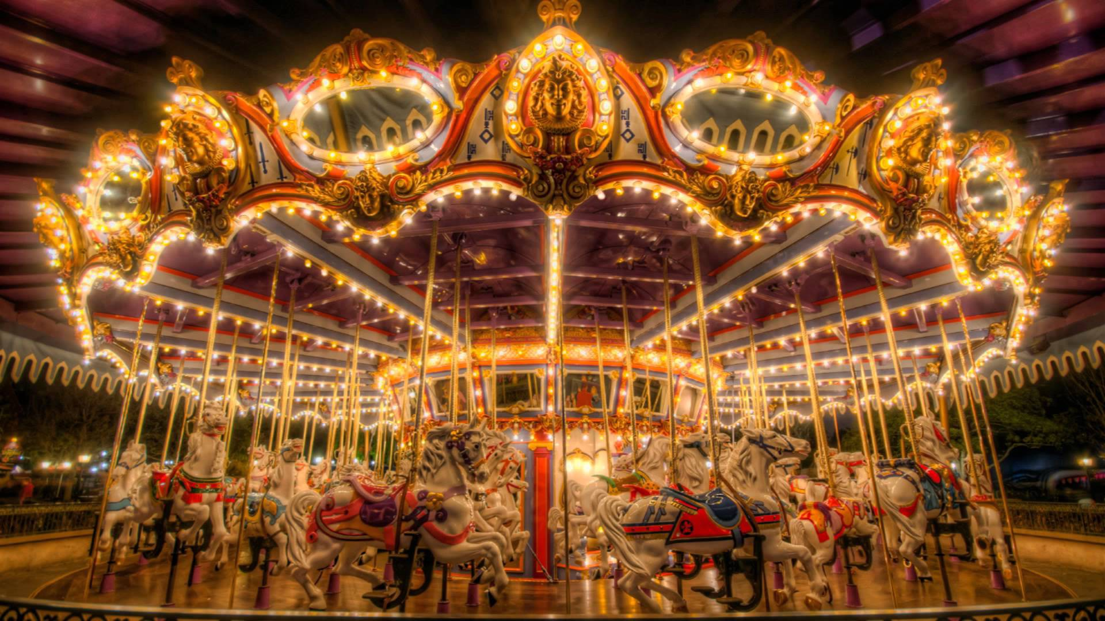
Our Final Design Plan
Notes:
Trevor
Picture Links:
https://image.shutterstock.com/image-vector/old-medieval-wooden-catapult-shooting-260nw-396067543.jpg
https://www.google.com/imgres?imgurl=https%3A%2F%2Finfrastructurepc.com%2Fwp-content%2Fuploads%2F2017%2F11%2Fb2e0f7_0812236eca964389b42af60cb91c9e18mv2.jpg&imgrefurl=https%3A%2F%2Fwww.infrastructurepc.com%2Fdrawbridges%2F&tbnid=5SoZ95jM1_6y7M&vet=12ahUKEwiTmfuR64ntAhXFB1kKHQTaCecQMygKegUIARDmAQ..i&docid=e0T04fbjV10vGM&w=1244&h=700&q=drawbridge&ved=2ahUKEwiTmfuR64ntAhXFB1kKHQTaCecQMygKegUIARDmAQ
https://www.google.com/search?q=surprise&tbm=isch&ved=2ahUKEwijmZ-V94ntAhWSWN8KHcVOAXMQ2-cCegQIABAA&oq=surprise&gs_lcp=CgNpbWcQAzIECAAQQzIECAAQQzIHCAAQsQMQQzIECAAQQzIFCAAQsQMyBwgAELEDEEMyBAgAEEMyBAgAEEMyBwgAELEDEEMyBAgAEEM6AggAOggIABCxAxCDAVDVIVimMmCTM2gEcAB4AIABswGIAfYHkgEEMTEuMZgBAKABAaoBC2d3cy13aXotaW1nwAEB&sclient=img&ei=KvGzX6PcIpKx_QbFnYWYBw&bih=602&biw=1280&rlz=1C5CHFA_enUS815US815#imgrc=k7jpNn1Cx2vBpM
https://www.google.com/url?sa=i&url=http%3A%2F%2Fm.tayee.com.cn%2Ftayee-electric%2Fproduct%2Ftyx1-emergency-push-button-box.html&psig=AOvVaw3PtcRSl1RD0xAGfF4pmHjm&ust=1605714464462000&source=images&cd=vfe&ved=0CAIQjRxqFwoTCJDLosf3ie0CFQAAAAAdAAAAABAE

Slide 3
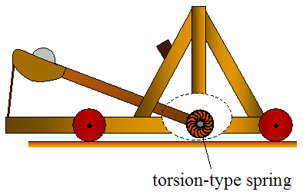
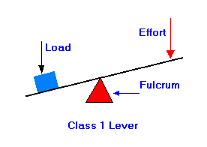
Catapult
Traditionally use torsion to generate angular acceleration/velocity
v=r⍵
Implementing a simpler version, a lever and fulcrum
Torque = rfsinθ - creates mechanical advantage
Range of Projectile: R=(v^2sin(2θ))/g

Slide 4
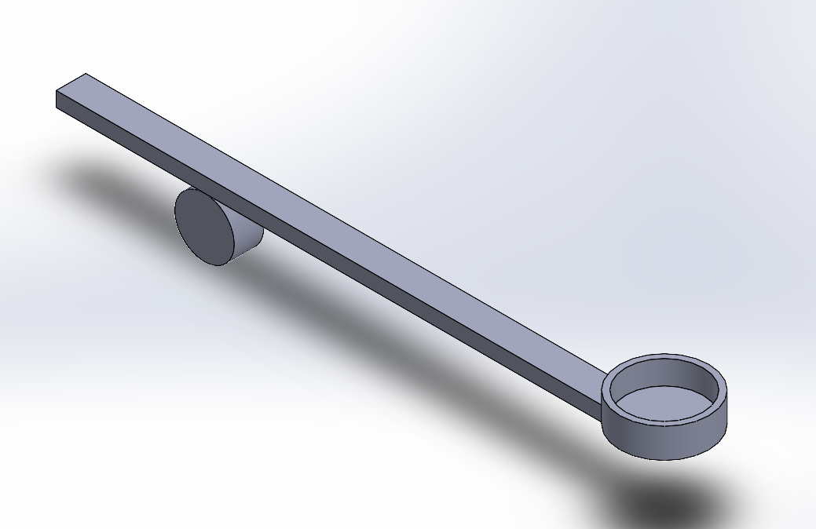
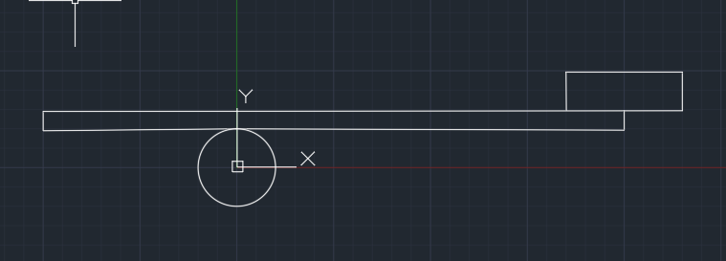
Catapult

Slide 5
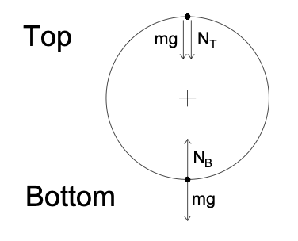
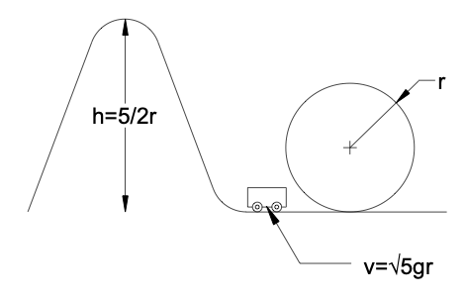
Loop
The Science Behind A Loop…
“Weightless” feeling at the top
Minimum velocity -> Height
Notes:
Picture Link:
https://www.google.com/search?q=ferris+wheels&rlz=1C5CHFA_enUS815US815&source=lnms&tbm=isch&sa=X&ved=2ahUKEwjilou9moPtAhVoFlkFHZ2LDyAQ_AUoAXoECAgQAw&biw=1903&bih=889#imgrc=fFCu0aQEzHa78M
https://learning-center.homesciencetools.com/article/amusement-park-physics/

Slide 6
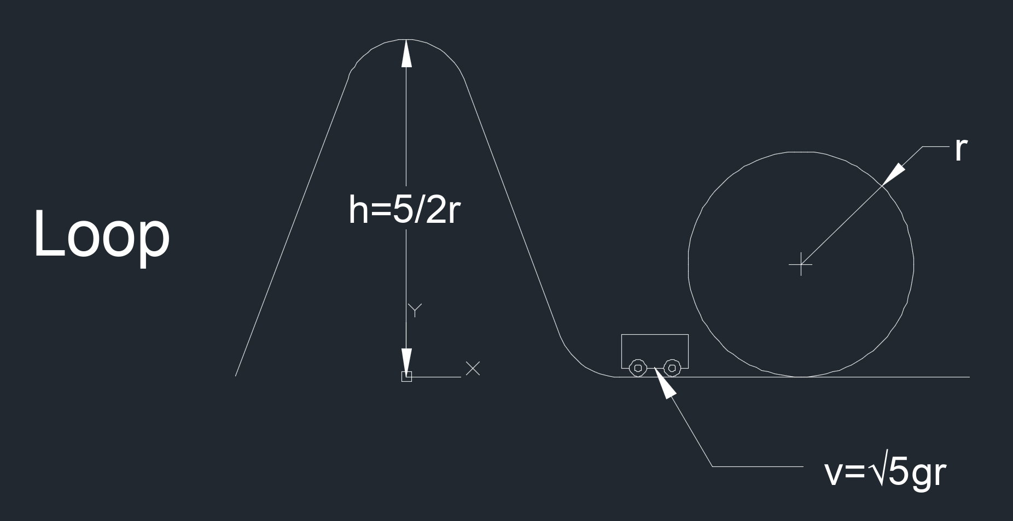
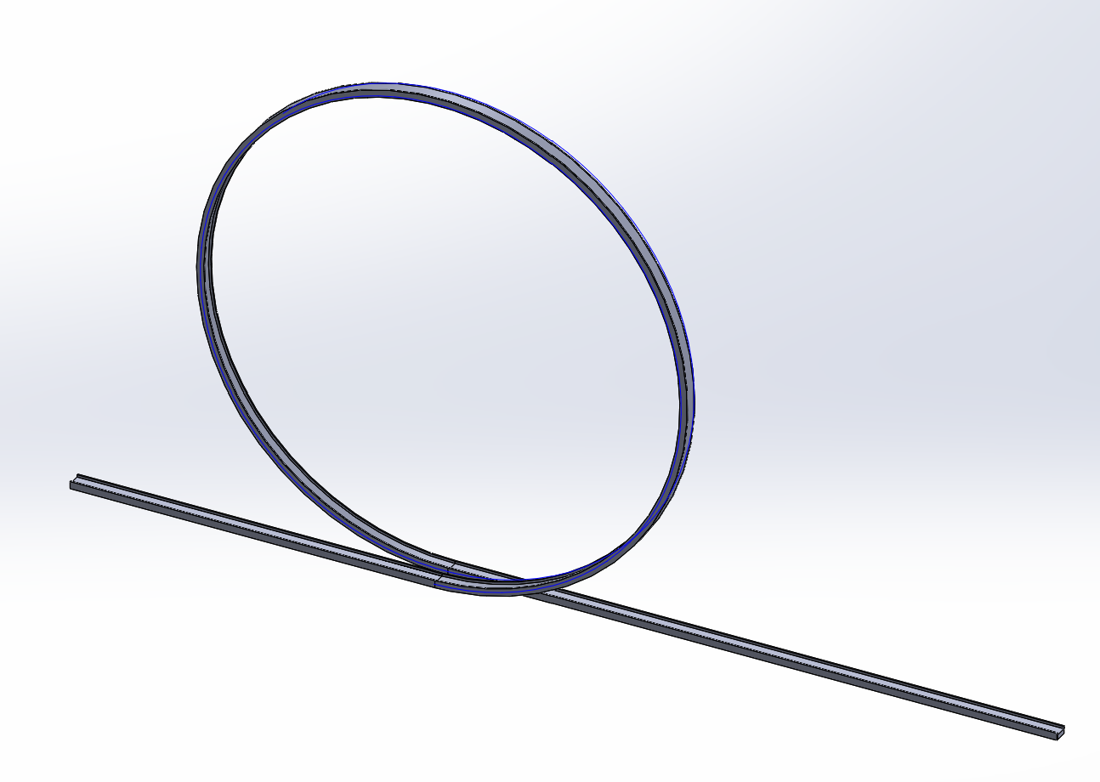
Loop

Slide 7
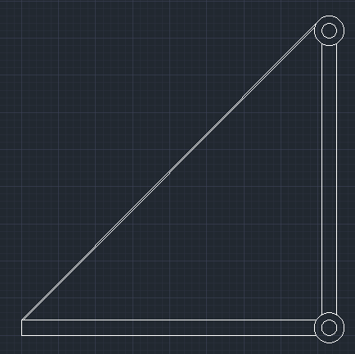
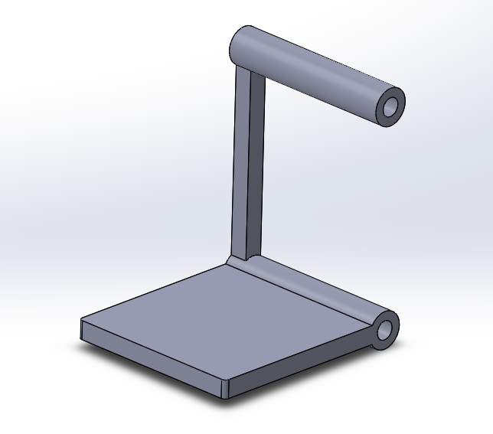
Drawbridge

Slide 8
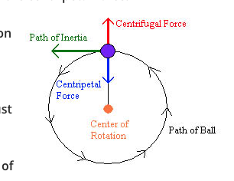
Ferris Wheel
The Science Behind A Ferris Wheel…
Wheel & Axle Simple Machine
Centripetal Acceleration keeps passengers in rotation
Motors are main source of power
Safety precautions include cables, dampers, and emergency generators
Notes:
Picture Link:
https://www.google.com/search?q=ferris+wheels&rlz=1C5CHFA_enUS815US815&source=lnms&tbm=isch&sa=X&ved=2ahUKEwjilou9moPtAhVoFlkFHZ2LDyAQ_AUoAXoECAgQAw&biw=1903&bih=889#imgrc=fFCu0aQEzHa78M
https://learning-center.homesciencetools.com/article/amusement-park-physics/

Slide 9
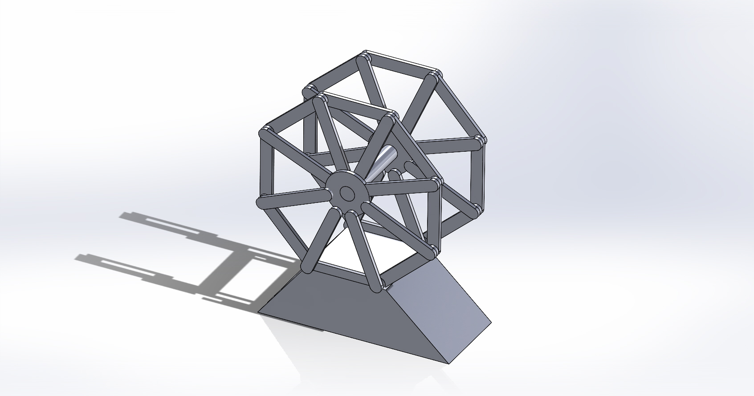
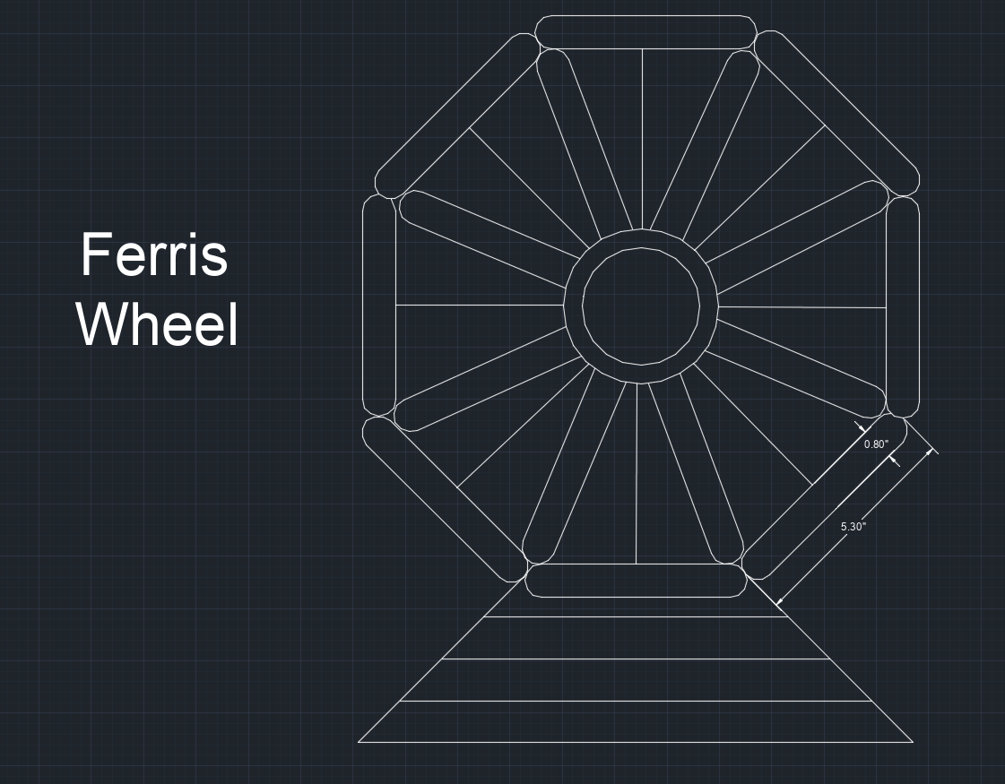
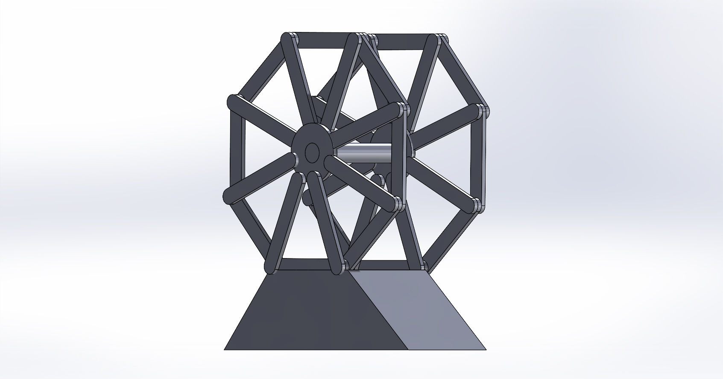
Ferris Wheel

Slide 10
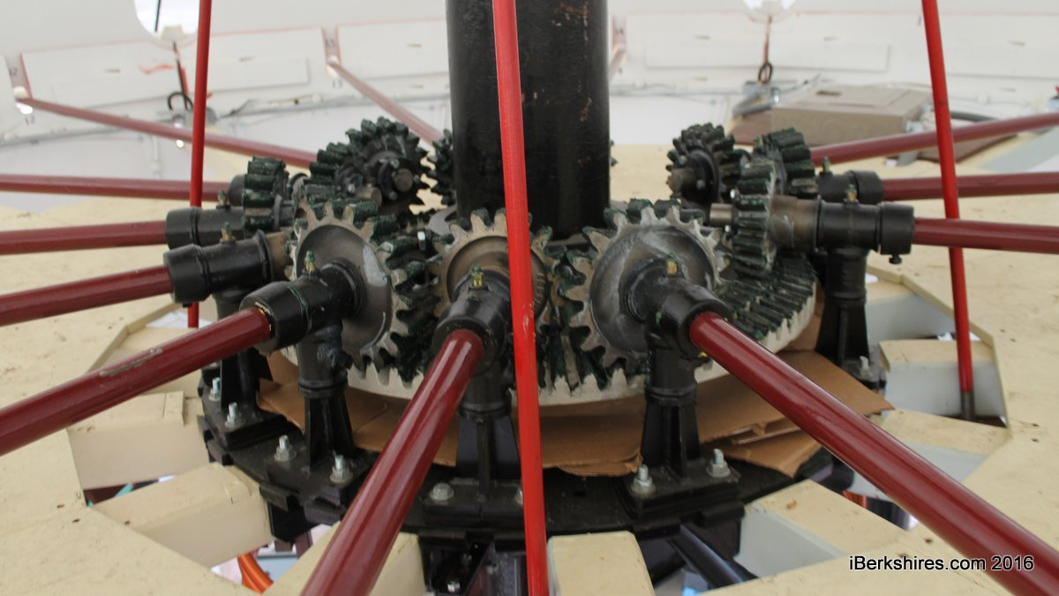
Carousel
The Science Behind A Carousel…
Wheel & Axle Simple Machine
Centripetal Acceleration keeps passengers in rotation
Motors and internal pulley system attached to gears power ride
Notes:
Picture Link:
https://www.google.com/search?q=carousel&rlz=1C5CHFA_enUS815US815&source=lnms&tbm=isch&sa=X&ved=2ahUKEwiQp4KJm4PtAhXQwVkKHYhMAZ0Q_AUoAXoECA8QAw&biw=1903&bih=889#imgrc=XMrDOthAJZRjJM
https://www.google.com/search?q=the+gears+inside+a+carousel&rlz=1C5CHFA_enUS815US815&tbm=isch&source=iu&ictx=1&fir=R-nwsh6GIWWJuM%252CpM0hX9VSiTjY-M%252C_&vet=1&usg=AI4_-kQ4AJO0RAlCFNUjroglXyQogKosGg&sa=X&ved=2ahUKEwjU9o67o4PtAhUEmuAKHVOgC4cQ9QF6BAgGECU#imgrc=R-nwsh6GIWWJuM

Slide 11
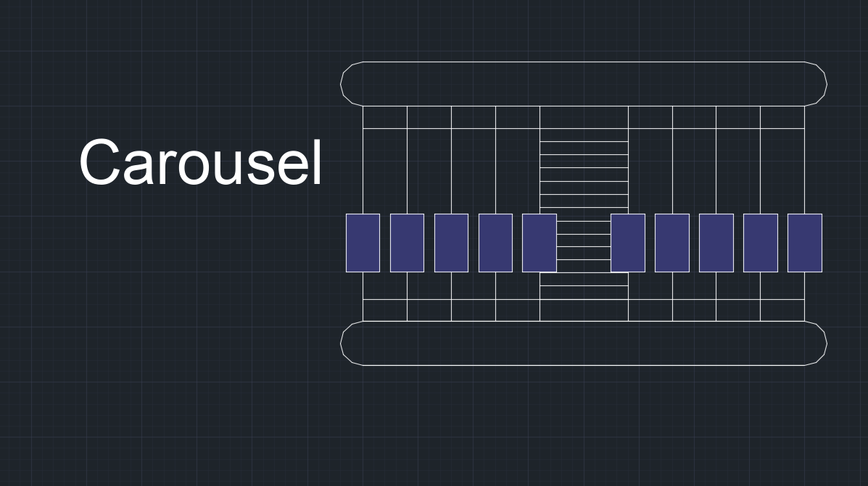
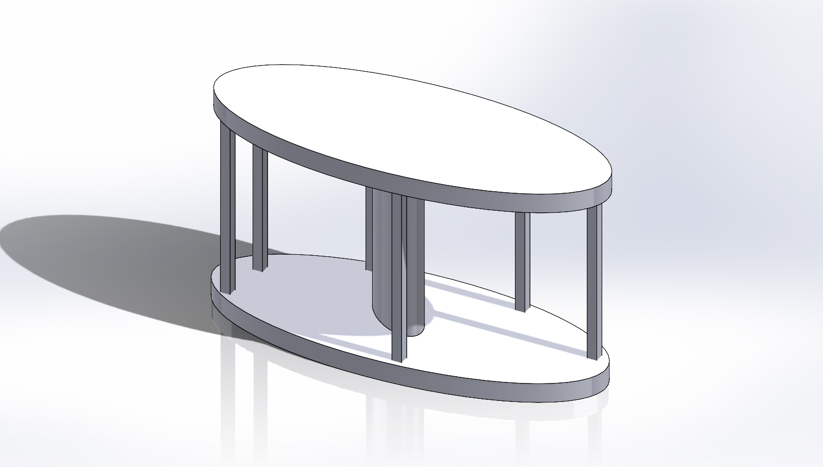
Carousel/Merry-Go-Round

Slide 12
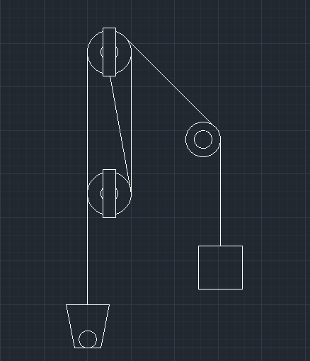
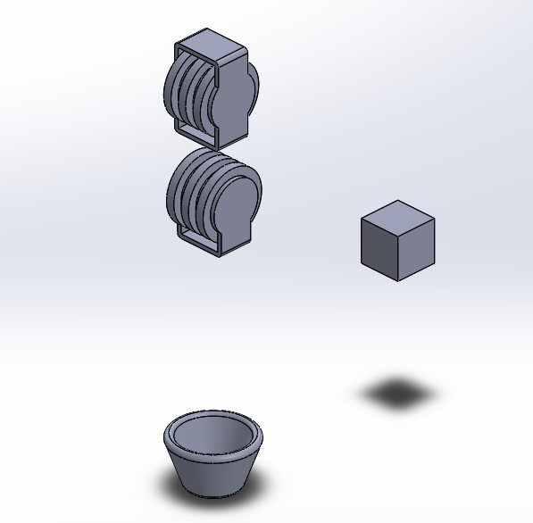
Pulley

Slide 13
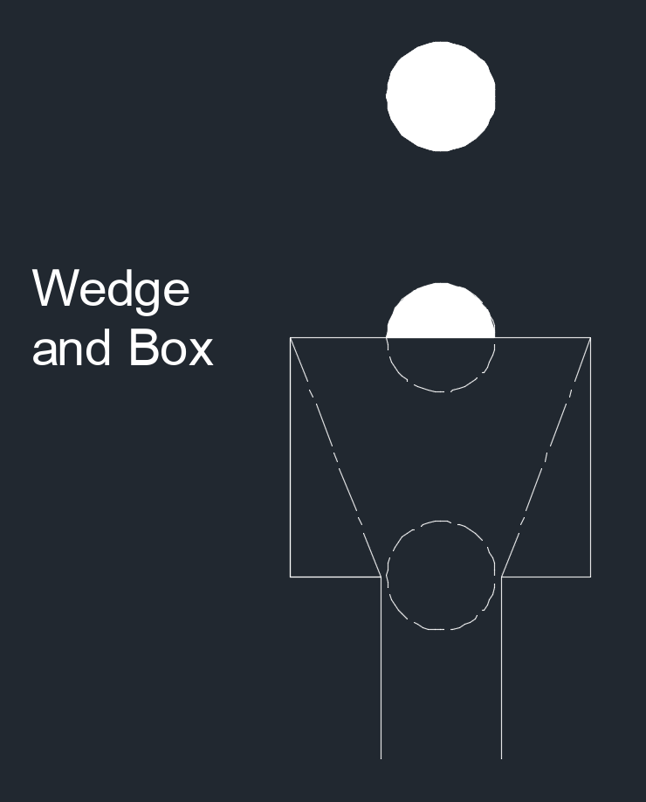
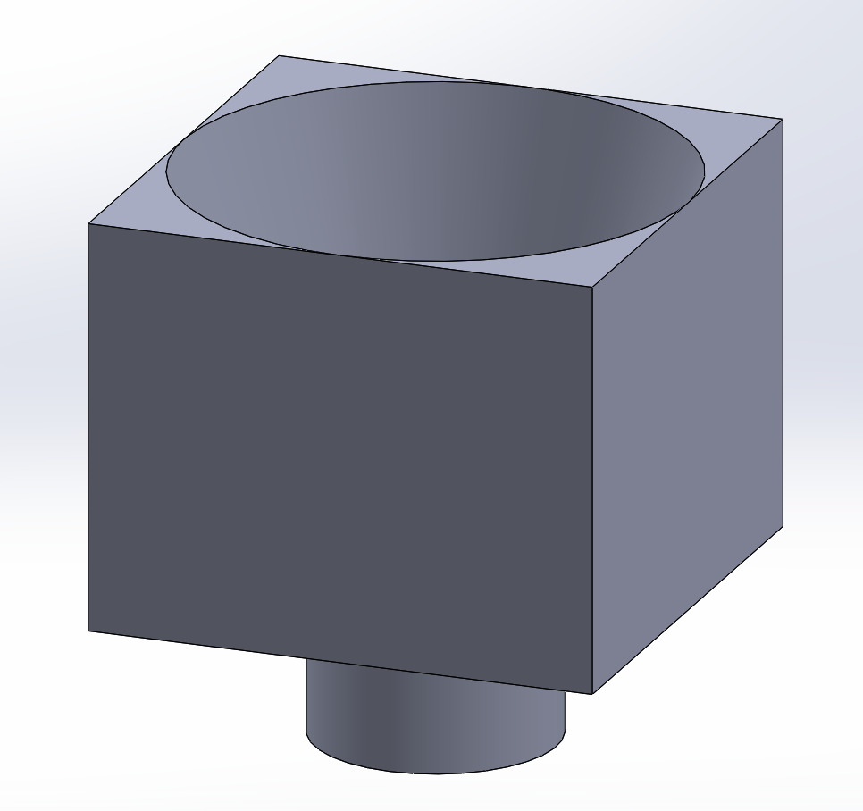
Wedge & Box

Slide 14


Project Concerns
Our concerns as of now are…
Materials
Who will gather which materials?
Where will we collect our materials from?
Coordination of Design
How will we ensure the pieces work together to achieve end goal?
How will we perfect the timing to ensure the end goal is met?
Notes:
Jenna
Image Links:
https://www.google.com/search?q=picture+of+cardboard+stack&rlz=1C5CHFA_enUS815US815&source=lnms&tbm=isch&sa=X&ved=2ahUKEwj975GdmYPtAhVNEFkFHYr4CV0Q_AUoAXoECAgQAw&biw=1903&bih=946#imgrc=2fDNspeXif8LKM
https://www.google.com/search?q=picture+of+timer&tbm=isch&ved=2ahUKEwicr56emYPtAhVZZ98KHXNfAlsQ2-cCegQIABAA&oq=picture+of+timer&gs_lcp=CgNpbWcQAzICCAAyAggAMgYIABAFEB4yBggAEAUQHjIGCAAQBRAeMgYIABAIEB4yBggAEAgQHjIGCAAQCBAeOgQIABBDOgUIABCxA1Dd2gNYxuoDYO3rA2gBcAB4AIABlwGIAZ8HkgEEMTEuMZgBAKABAaoBC2d3cy13aXotaW1nwAEB&sclient=img&ei=XmmwX5yIBNnO_QbzvonYBQ&bih=946&biw=1903&rlz=1C5CHFA_enUS815US815#imgrc=TGfh8dUiEURo8M

Slide 15
Citations
“Ferris Wheel Physics.” Observation Wheel Directory, 6 June 2013, www.observationwheeldirectory.com/ferriswheelarticles/ferris-wheel-physics/
“Observation Wheel Technology.” Observation Wheel Directory, 7 July 2013, www.observationwheeldirectory.com/ferriswheelarticles/observation-wheel-technology/.
Citation: “Amusement Park Physics: Home Science Tools Learning Center.” Home Science Tools, 2 Jan. 2020, learning-center.homesciencetools.com/article/amusement-park-physics/.
“Carousel Construction - How Does a Carousel Work?” How Carousels Are Made? - How Does a Carousel Work?, www.historyofcarousels.com/carousel-facts/how-carousels-are-made/.
https://www.youtube.com/watch?v=upjI5dw8_Es&ab_channel=MattAnderson
https://www.youtube.com/watch?v=mqRCz6qlnKs&ab_channel=GregJohnson
“Catapult Physics.” Real World Physics Problems, www.real-world-physics-problems.com/catapult-physics.html.
Beck, Kevin. "How Does a Catapult Work?" sciencing.com, https://sciencing.com/a-catapult-work-4586404.html. 16 November 2020.

